Slide 1
Video Reconstruction from Randomized Video Frames
Group - 20
Team Members: Bhavya Kandhari, Dhinesh Babu Ramachandran,
Rahulrajan Karthikeyan, Vaishnavi Vivek Gadhikar

Slide 2
MOTIVATION
In some scientific experiments, there is a need to extract dynamic information from a series of static images. For example, at the SLAC National Accelerator Laboratory, proteins can be imaged at different conformations but the samples are destroyed in the process. In order to reconstruct the transformations between conformations, an algorithm is needed to order the randomized frames in the most likely temporal sequence.
The primary goal of our project is to reorder the randomized video and compare all the different possible methods at each step. The idea is to develop the process for 2D videos and generalize to 3D case and evaluate the effectiveness of the methodology to re order video frames.
Notes:
Feature matching ; sorting, post processing,

Slide 3
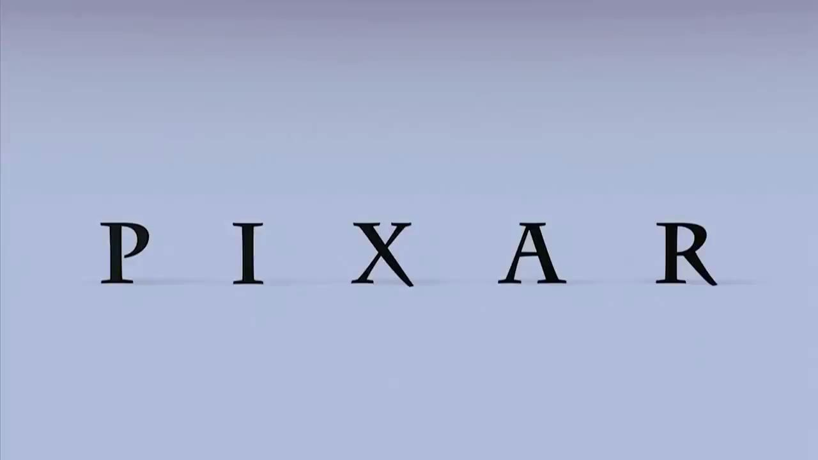
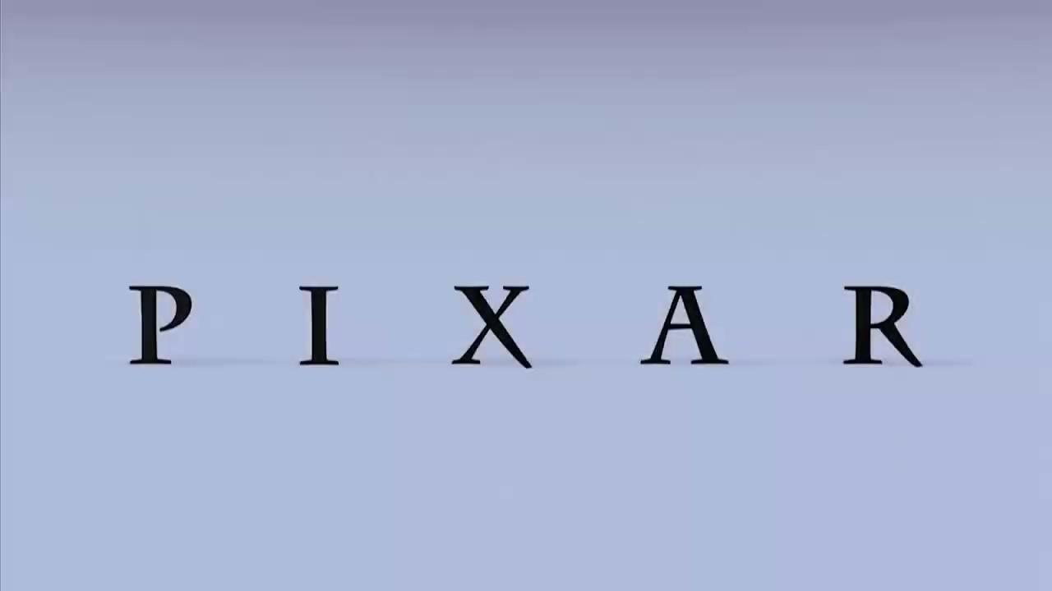
Input
Output

Slide 4
Relevant Work
Video reconstruction from frames that have been randomly shuffled is not a widely researched area. The first major development came in 2016, when Ned Danyliw proposed an algorithm which uses feature matching and sorting algorithms to reorder the shuffled video.

Slide 5
Our Approach
To conduct our experiment, we have modified the previously stated algorithm.
In the preprocessing stage, we downsample and grayscale the original video. The video is then shuffled and features are extracted using two feature detectors: ORB and SURF Feature detectors. The best possible feature detector is used based on the number of feature keypoints and descriptors generated.
Various distance metrics such as average distance, L2 norm, L1 norm and Quaternion distances are calculated solely from the extracted features.
The frames are then sorted based on the number of matches and distance metrics using various sorting algorithms: Growing approach, Hierarchical Clustering and TSP Solver. The best possible sorting order parameter and algorithm is then recommended based on results.

Slide 6
Preprocessing

Slide 7
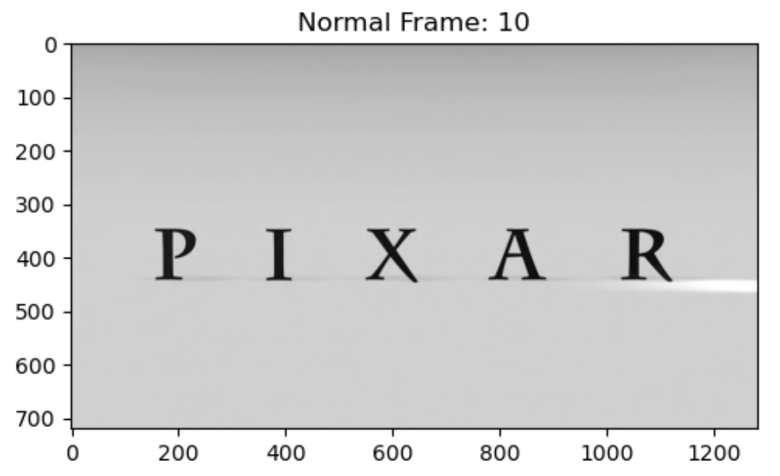
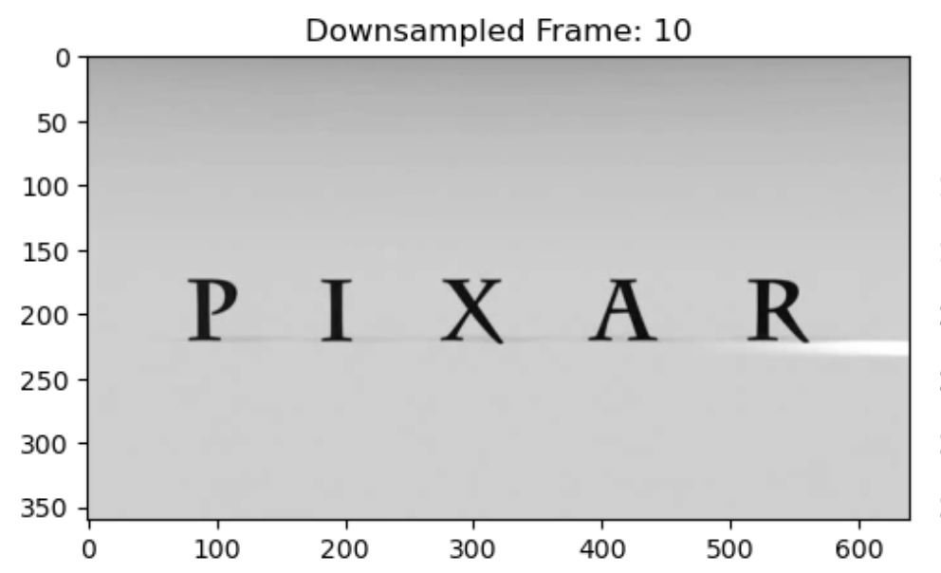
Preprocessing
The preprocessing stage is absolutely crucial
Greyscaling the video makes it easier to work with. The features are also matched in greyscale.
Downsampling the video removes the small changes and reduces computational load.
Feature matching and Cost Calculation.

Slide 8
Feature Matching
In computer vision, a feature is a measurable piece of data in your image which is unique to this specific object.
Feature descriptors are algorithms which take an input image and outputs features/feature vectors.
We have compared the following feature descriptors for our use case:
SIFT or Scale-Invariant Feature Transform
ORB or Oriented FAST and Rotated BRIEF

Slide 9
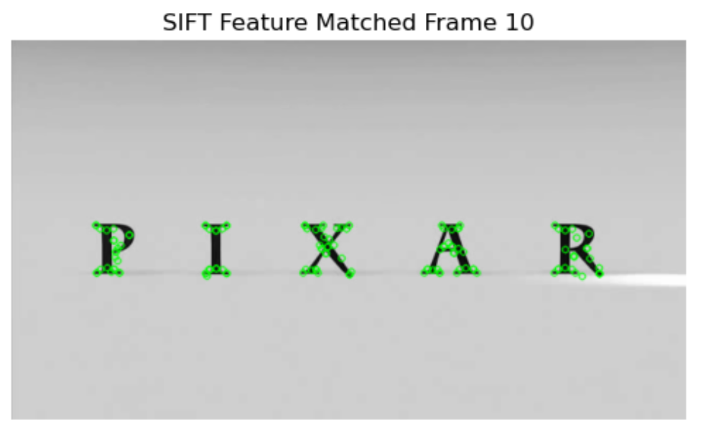
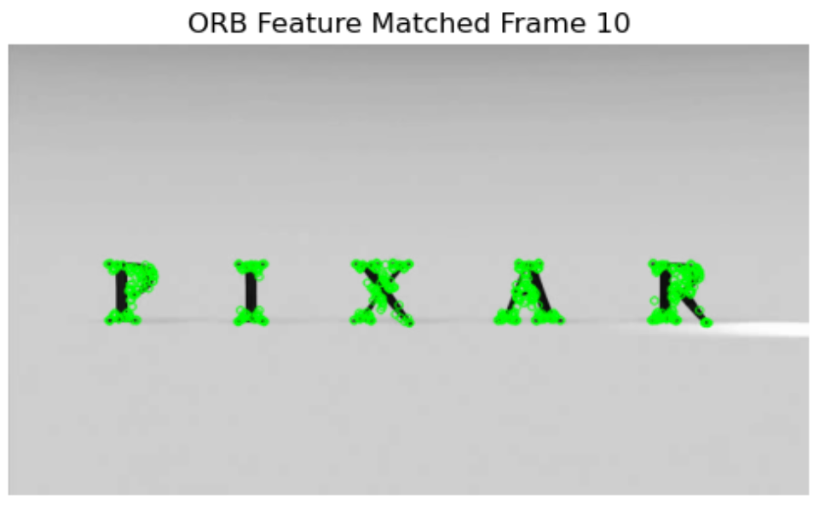
Results from Feature Extraction

Slide 10
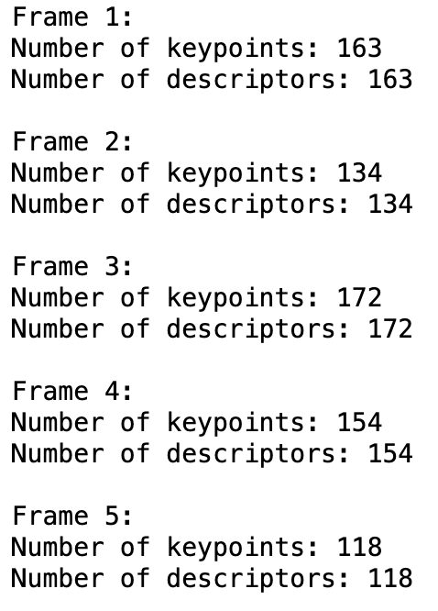
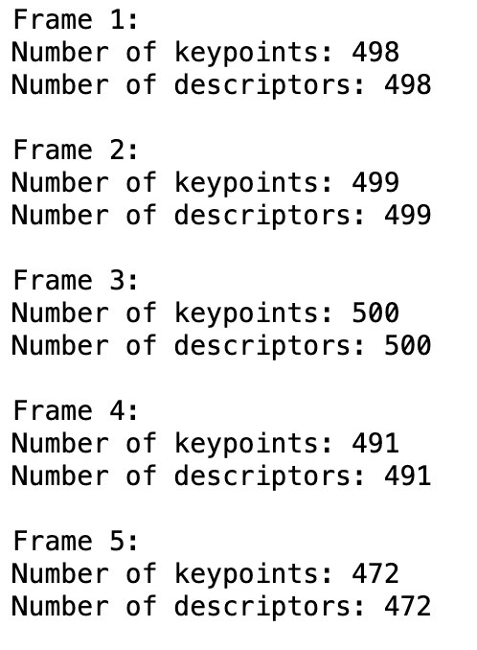
Based on the number of keypoints and descriptors, we decided to proceed with ORB feature detector.
SIFT Keypoints and Descriptors
ORB Keypoints and Descriptors

Slide 11
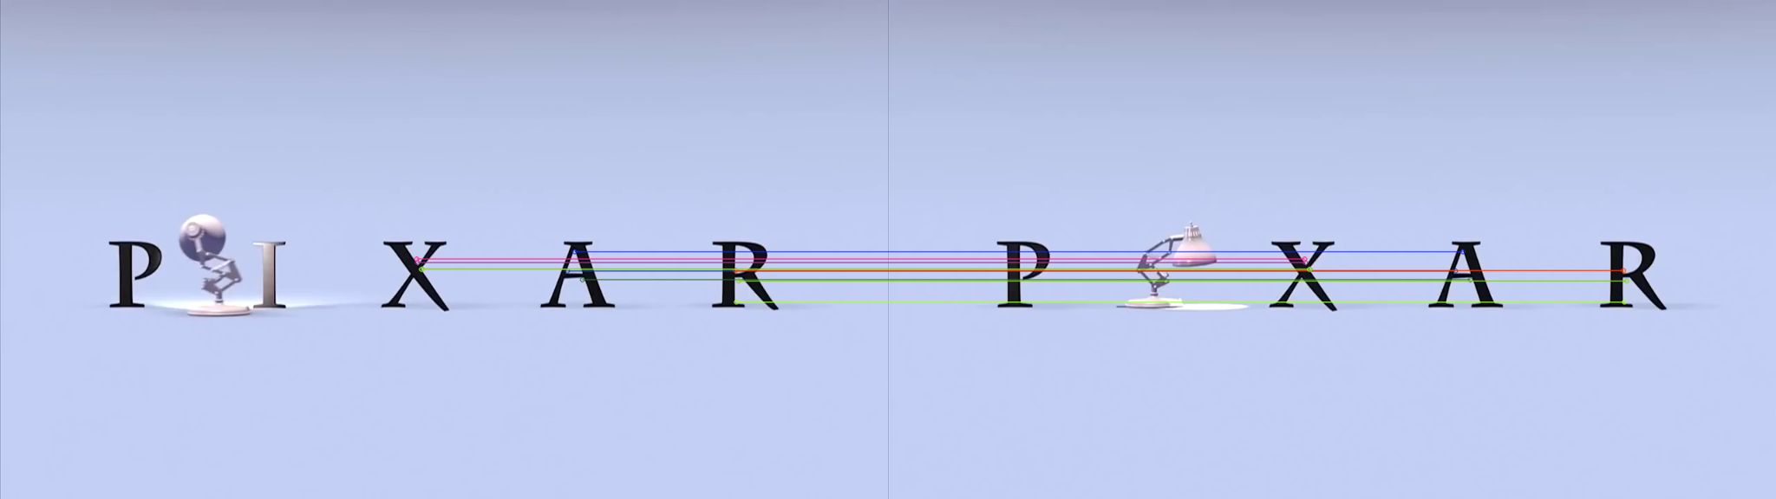
ORB Feature Extraction
ORB is basically a fusion of FAST keypoint detector and BRIEF descriptor with many modifications to enhance the performance.
The benefits of ORB feature descriptor are:
Faster
Computationally less expensive
ORB is free (SIFT and SURF are patented)
We used Brute Force Matcher with Hamming distance to match the features between two images.

Slide 12

ORB Feature Showcase
Original
Shuffled

Slide 13
Distance Metrics
After the features of each frame have been extracted, they are sent to a distance estimation algorithm that calculates various distance metrics.
We used various distance metrics such as:
Euclidean distance or L2 norm
Manhattan distance or L1 norm
Quaternion distance
On comparison, we found out that the type of distance metric used doesn’t have any effect.

Slide 14
Cost Matrix
There is a cost for “transforming” the given image to another image.
Similar image frames have a lower cost whereas different image frame have a higher cost.
The cost can be a variety of parameters such as:
L2 or Euclidean distance
L1 or Manhattan distance
Quaternion Distance
Average Distance of matched features between images
Number of features matched between the images.

Slide 15
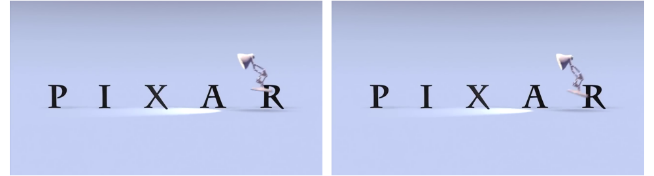
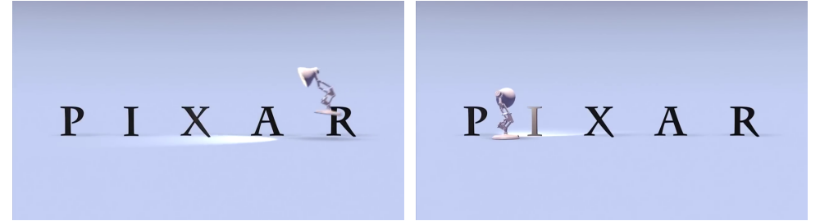
Low Cost
High Cost

Slide 16
Sorting

Slide 17
SORTING
After the preprocessing stage, we move to the sorting stage.
We have multiple parameters available for sorting the randomized frames:
Number of matches.
Average Distance between matches.
L2, L1 and Quaternion Distance between matches.
We use a variety of sorting algorithms:
Growing Approach
Hierarchical Clustering
Travelling Salesman

Slide 18
Growing Approach
1. Starts with a random frame.
2. Finds the nearest neighbor frame based on the Cost
3. Checks if the nearest neighbor frame is closer to the start or end of the constructed sequence.
4. Appends the frame to the end if it is closer to the end, otherwise starts the search from the start of the sequence and builds backwards.
5. Continues until all frames are sorted.

Slide 19
Growing Approach Algorithm Video

Slide 20
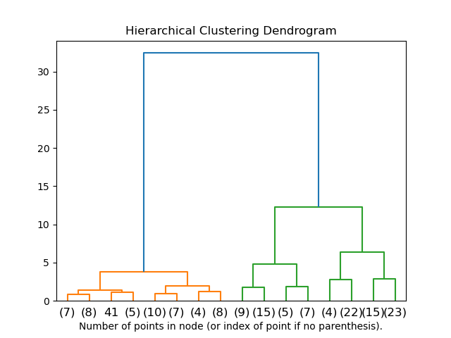
Hierarchical Clustering
Each observation starts in it’s own cluster and pair of clusters are merged as one moves up the hierarchy.

Slide 21
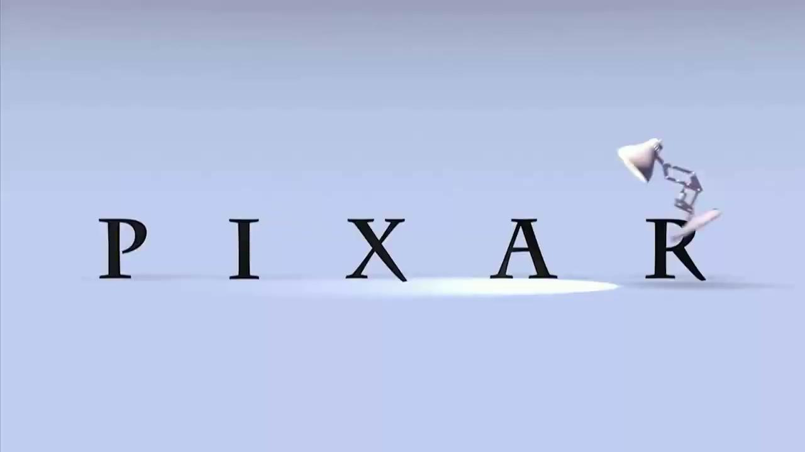
Hierarchical Clustering Algorithm Video

Slide 22
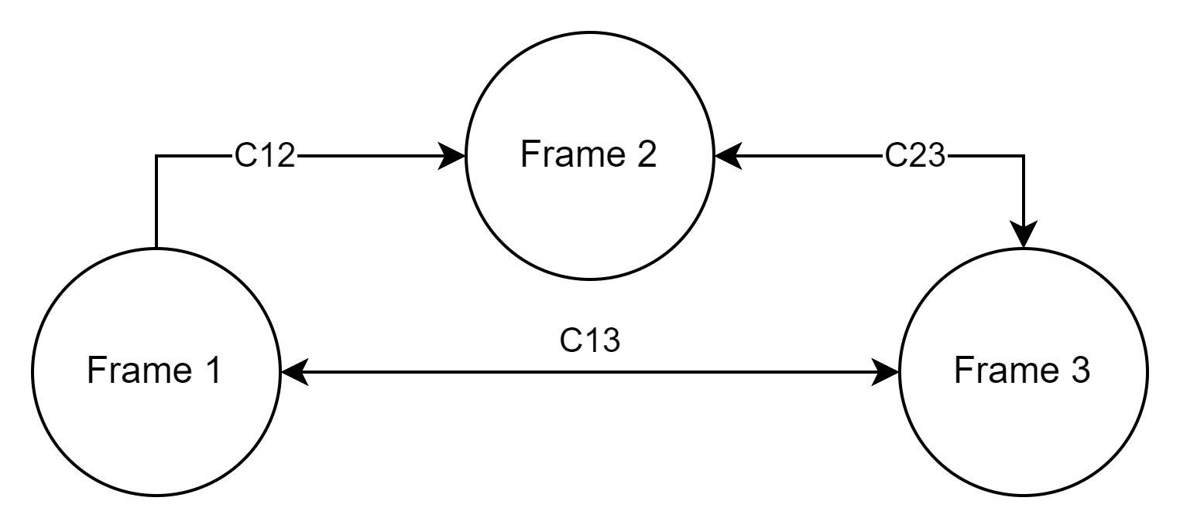
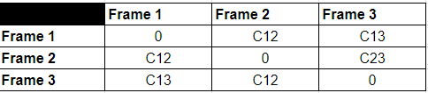
Travelling Salesman Solution
Our problem can be represented as a fully connected graph, with nodes as frames and edges as cost from the cost matrix. We want to go from Frame A to Frame B and evaluating all the permutations of nodes/frames with the least total cost. This algorithm is a variant of the travelling salesman problem.

Slide 23

Travelling Salesman Solution Video

Slide 24
All these results, have abrupt jumps, even if there is a good sense of clustering among the frames.
This is due to unknown start and end.
Retrying with non shuffled first few frames and last few frames.

Slide 25
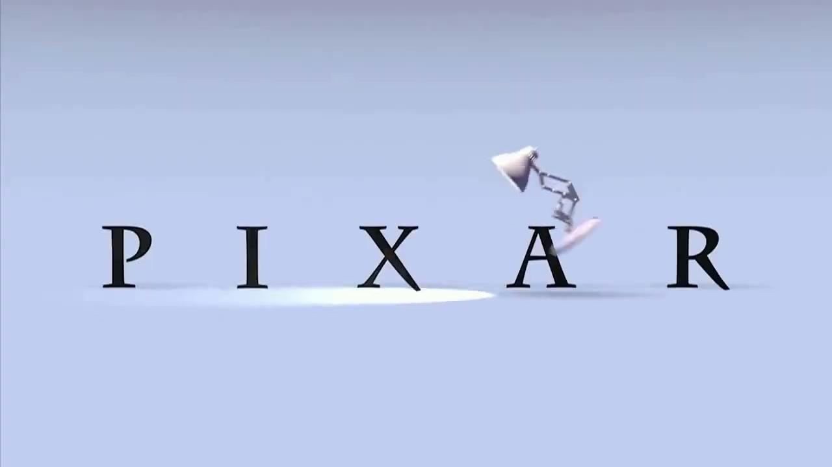
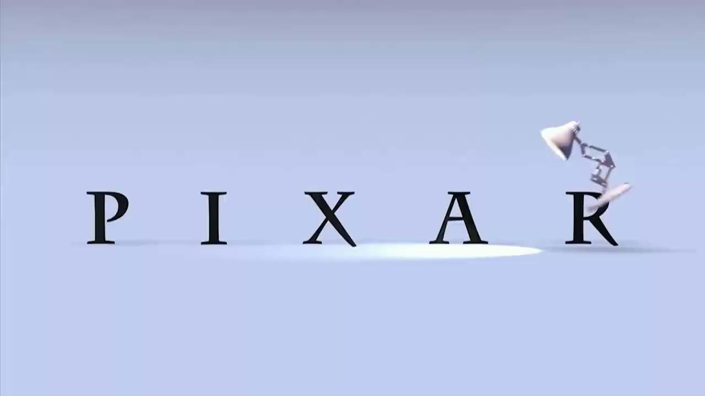
Shuffled
TSP
Grow
H-cluster

Slide 26
Performance Metrics

Slide 27

Quantifying Results and Performance
While it is easy to qualitatively evaluate the sorted videos, it is hard to compare the results quantitatively.
The algorithm shouldn’t be penalized too heavily if the reconstruction’s adjacent frames are close to the frame.
It should not be overly penalized if it selects a frame that is very far away versus one that is far away.
It is as bad to jump 30 frames as it is to jump 300 frames.
This lead us to use the following logistic performance metric that was also used in Ned Danilyw’s research:

Slide 28
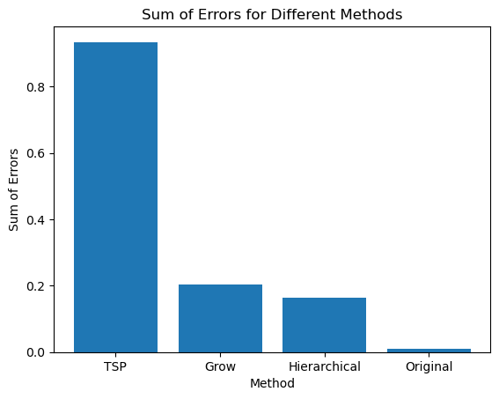
Not Preserving Starting and Ending Frames
Higher error is worse

Slide 29
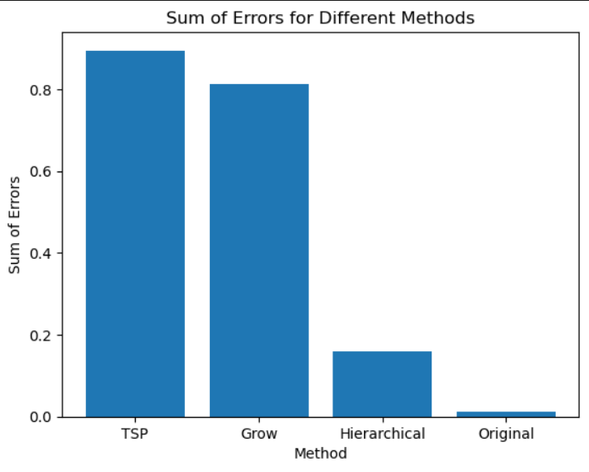
Preserving Starting and Ending Frames
Higher error is worse
By preserving the starting and ending frames, the algorithms performed qualitatively better.
Higher error is worse

Slide 30
Quantifying Results and Performance
Based on the graphs, hierarchical clustering performed better, but on qualitative analysis, we can say that's not the case.
Hence there is no “proper” way to quantify the error and the error function needs to be changed in the future.

Slide 31
Bottlenecks to Consider / Our Observation
The algorithm doesn’t perform well when there are scene jumps due to abrupt change in the feature matches.
The shuffling order can determine the output reconstructed video. If the first few frames and the last few frames are kept constant, the algorithm qualitative performance improves significantly.
Complex brightness changes can affect the feature matches generated.
The error function doesn’t scale properly for short video as the weight of one mismatch is much higher.
After shuffling, we’re unaware about the flow of time.

Slide 32
CONCLUSION
This algorithm shows that randomized video frames can be accurately reordered in short bursts using preprocessing, feature-based matching and finally sorting the frame according to the number of feature matches. On qualitative evaluation, we can come to the conclusion that the TSP solution gives the best result. Hence, we were able to provide a better alternative working algorithm to reconstruct the randomized sequences.

Slide 33
Shuffled
TSP
Grow
H-cluster

Slide 34
Additional Work
The following possibilities were excluded due to poor performance:
Apart from the 3 Main sorting, we tried and omitted Merge Sort
Apart from number of matches as “cost”, we tried the following parameters for sorting:
Optical Flow
Distance metrics between matches.
L1,L2 and Quaternion Distance
Average distance

Slide 35
FUTURE WORK AND RECOMMENDATIONS
The algorithm performed well when reconstructing shuffled 2D videos. However, it needs to be improved to be more robust to reconstruct the video sequences.
Suggest potential optimizations for the sorting algorithms used and explore the possibilities for integrating additional sorting algorithms into the comparison.
Better error function.
Optimize the scene frame detection.
Expand the solution to 3D videos.
Motion estimation techniques can be used to increase the robustness to noise and calculating the distance between the frames.
Notes:
Feature matching ; sorting, post processing,

Slide 36
THANK YOU

